Slide 1
Resource Development: Financial Responsibilities of Nonprofits
Judith Millesen, PhD
Association Options

Slide 2
Disclaimer
This presentation is a compilation of several resources that were created by Judy Millesen and also pulled in from other key resources that Judy works in collaboration with as a consultant.
The information in this presentation does not provide nor replace legal, accounting or insurance advice; be sure to utilize professional counsel in the areas of legal, accounting or insurance. Presenter accepts no liability if there are any damages caused by your organization due to the use or interpretation of the information in this document.
Association Options, LLC has exercised due and customary care in preparing this presentation but has not, save as specifically stated, independently verified information provided by others in this document. No other warranty, express or implied, is made in relation to the conduct of the course or the contents of this document. Therefore, Association Options, LLC assumes no liability for any loss resulting from errors, omissions or misrepresentations made by others.
Any recommendations, opinions or findings stated in this presentation are based on circumstances and facts as they existed at the time Association Options, LLC performed the work. Any changes in such circumstances and facts upon which this presentation is based may adversely affect any recommendations, opinions or findings contained within.

Slide 3
Legal Fiduciary Responsibilities
To be a fiduciary is to be a good steward
Duty of Care
Duty of Loyalty
Duty of Obedience
Fiduciary-related Policies
Conflict of Interest
Confidentiality
Anti-Trust

Slide 4
Financial Responsibilities of the Nonprofit Board
Individual Responsibility
Voting for financial policies and the budget
Collective Responsibility
Fiduciary responsibility to serve as a steward of public
and charitable funds
The board may delegate authority for some financial management duties to senior staff, the finance committee, or a treasurer

Slide 5
Strategic
Approving and monitoring policy
Setting goals/ strategic direction
Committee leadership
Analysis and reporting of financial status
Overseeing financial operations
Operational
Developing and monitoring budgets/financial plans
Managing cash flow
Monitoring controls/ overseeing transactions
Managing grants and contracts
Bookkeeping/ supervising booking
Transactional
Clerical tasks that support the accounting function, such as copying, filing, and making bank deposits
Board Financial Tasks
Governance
Management
Implementation
Authority Flow of Communication
Source: Board Development Program, Alberta Culture, www.albertabdp.ca

Slide 6
Financial Oversight
Establish budget guidelines
Oversee financial management
Ensure the necessary financial policies are in place
On a regular basis, review financial statements, understand what they say, and ask questions to ensure accurate understanding
Review audit report and take action as needed

Slide 7
Financial Responsibilities
Each Board member is responsible for reviewing all financial reports and tax returns
The Finance Committee, with staff assistance, will present all financial reports to the Board
The Finance Committee will review the draft annual budget prepared by the staff prior to presentation to the Board

Slide 8
Financial Statements
Integral part of any business or organization
Helps the Board understand the present financial state of the organizations
Necessary to achieve and evaluate progress toward the organization’s mission-related goals and objectives
Useful for decision making

Slide 9
Financial Statements
Interim Statements
Internally prepared
Prepared monthly
Audited Statements
Prepared annually
Include Auditor’s Report and Footnotes
Tax Statements
Form 990

Slide 10
Interim Statements
What you will see & things to keep in mind
The current year budget – this is essentially a prediction of what kind of money was expected to come in and go out
Actual income and expenses – this is the money that was actually received or spent
Prior year – this is a comparison number
Variance – the difference between what you thought and what actually happened; can be expressed as a $ amount or %
Explanation – this is text that helps put what you see into perspective

Slide 11
Asking Good Financial Questions
Have we run a gain or loss?
Are our key sources of income rising or falling?
Are our key expenses, especially salary and benefits, under control?
Do we have sufficient reserves?
Is our cash flow projected to be adequate?
Where are we compared to our budget?
Is our financial plan consistent with our strategic plan?
Are we filing all needed reporting documents on a timely basis?
Are we fulfilling our financial legal obligations?

Slide 12
Sound Financial Management – Summed Up
Manage “How”
Income is generated (contributions or earnings)
Money is spent
Assets and net assets are protected/ invested
Finances are presented and accounted for
Activities Related to Financial Management:
Budgeting
Accounting and financial statements
Reporting and analysis
Developing and monitoring financial policy
Managing cash flow
Transactions and internal controls
Managing grants and contracts
Risk management
Annual reporting, income tax filing and statutory remittances

Slide 13
Internal Controls – What comes to mind?
Fiduciary oversight
Segregation of duties
Fraud prevention
Monitoring controls
Policies and procedures
Reconciliation processes
Preventative controls

Slide 14
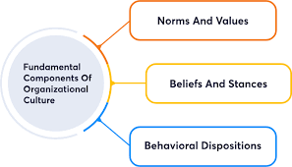
Internal Controls - Three Key Areas
Organization Culture
Set the right tone at the top
Create a culture of financial discipline
Promote transparency
Polices and Procedures
Develop
Acknowledge
Approve
Leveraging Technology
Software integration
Business rules
Restricted access
Audit trails

Slide 15
What This Looks Like – Organization Culture
 | Behaviors | Processes/Transactions
Set the right tone at the top | Leadership leads by example | Leadership submits receipts for approval
Financial discipline | Fiscal policies and procedures are “living” documents Leadership regularly monitors financial results | Staff are regularly trained on new policies Budgets are approved by the board and regularly monitored by the board and executive leadership
Transparency | Leadership promotes and encourages an open and transparent environment | Establish policies that promote transparency (e.g., conflict of interest, whistleblower)

Slide 16
What this Looks Like – Policies & Procedures
 | Reduces risk by: | What you can do:
Acknowledge – Revenue & Donors | Providing a check and balance for funds flowing into the organization | Regular reconciliation between finance and development
Approve – Agreements & Credit Cards | Making staff aware of organization-wide purchasing policies and allowing management to review expenses | Purchasing approval thresholds Clarity on appropriate use of credit cards
Segregate – Payroll Responsibilities & Major Purchases | Ensuring no one person has control over payroll and large expenses | Staff additions/changes and payroll processing are performed by different people
Approve – Policies | Promoting transparency | Conflict of interest disclosure from both board and staff Whistleblower hotline
Approve - Procedures | Creating awareness of how to protect against threats to privacy and/or systems | Staff training on what to do when encountered emails or phishing attempts

Slide 17
What This Looks Like – Leveraging Technology
Examples of technology controls:
Software Integration
Working with the Bank
Business Rules
Purchasing Cards
Restricted Access
Automated Bill Pay
Audit Trails
No Blank Checks

Slide 18
Understanding Risk
Compliance – violation of laws, policies, regulations
Financial – fraud, misappropriation of funds
Governance – ineffective oversight
Operational – poor service delivery, misuse of human capital
Information security – exposure of nonpublic information
Reputation – loss of goodwill or status
Strategic – failure to keep the organization strong and relevant
Risk takes many forms but, essentially, is anything that affects an organization’s ability to meet its objectives and preserve its reputation.

Slide 19
Failure to Manage Risk Could Lead to:
Loss of major funding
Unsuccessful fundraising projects
Failure of a project or initiative
Inadequate response to emergencies
Programs and services no longer in demand
Excessive cost of human and other resources
Loss and theft of information
Inability to perform functions that depend on technology

Slide 20
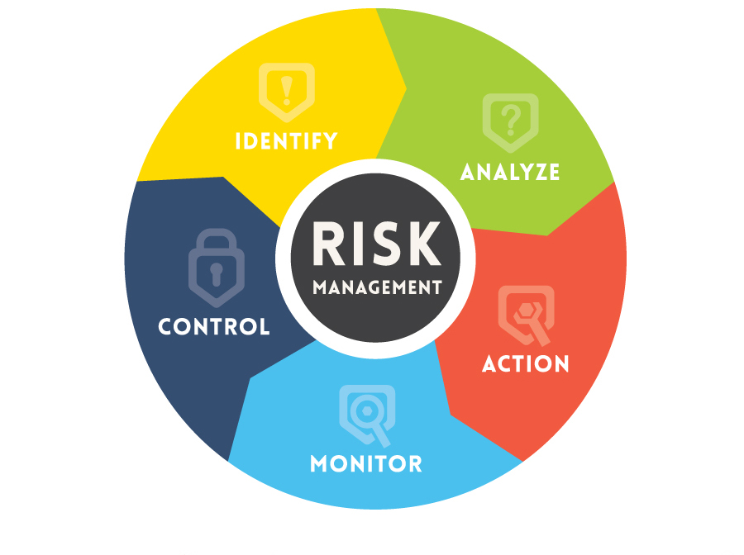
Risk Management
Identifying, assessing, and working to mitigate (lessen the consequences of) risks in your organization’s work
We do this by:
Assuring there are processes in place – written guidelines that help you ask the right questions
Board and staff identification of risks and consequences
Follow tested practices and control measures to manage the risk

Slide 21
Manage Risk
Four ways to manage risk
Avoid it – could be good or could mean missed opportunities
Transfer risk (share it) – insurance is one way to share risk
Mitigate risk (lessen it) – develop procedures with checks and balances to detect and reduce the likelihood of risk (e.g., internal controls, accurate record-keeping
Accept risk – if there is unlikely to be harm, perhaps the risk is warranted

Slide 22
Monitor Risk
Monitoring and learning from risk involves questions such as:
What are we doing about the major risks we have identified?
Are we achieving the results we planned?
Are we monitoring and learning from control breakdowns and losses?
Do we have the necessary guidelines or policies and procedures?
Are “near misses” recorded, tracked and used for learning?
How well are we doing in managing risk?
The specific questions will depend on the organization. The answers will come from the processes for measuring, monitoring, and reporting risk.

Slide 23
How can I help? What questions remain?

